Slide 1
Formative Evaluation of the
Vitendo4Africa Mentoring Program
December 6, 2018
Daniel Ferris
Jacob Fussell
Melissa Stone
Malcolm Townes
Instructor: Nhial Tutlam, Ph.D.
Notes:
Get here at 4:15pm. Start at 4:30pm. Presentation at 5pm.

Slide 2
Background and Objective
Notes:
Jake
1 what the original objective of the mentorship
2 what previously has been done in the field or are similar programs that have been done
3 how does the V4A program fit in to the literature as a whole

Slide 3
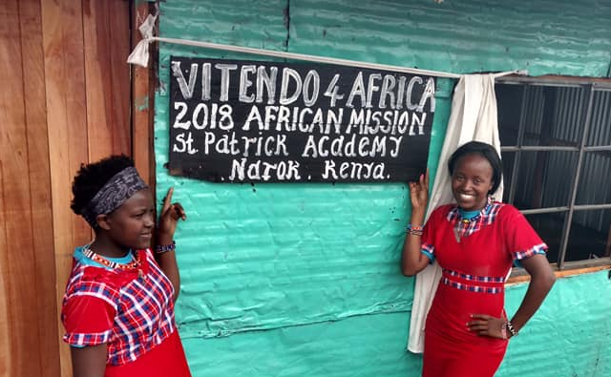
Mentorship Programs, Public Policy, and Funding
History/Emergence of Mentorship Programs¹
Modern mentorship programs began in the late 1980s
Federally funded and various federal bipartisan program supports since mid-90s
Today, an estimated 2.5 million youth mentorship program participants
Public and private funding environment²
While individual programs receive significant government support, there is no long term strategy or mechanism to fund youth mentorship programs
Estimate around $500 million in private/philanthropic funds
No known research to date has captured total state/local mentorship funding
1 Fernandez-Alcantara, A. (2015). Vulnerable Youth: Federal Mentoring Programs and Issues. Congressional Research Service. 2 Walker, G. (2007). Mentoring, Policy, and Politics. Public/Private Ventures.
Notes:
We recognize that funding is often an issue and may be a limiting factor when review possible suggestions for program improvement as well as other logistical issues.

Slide 4


Vitendo 4 Africa Mission
To service African immigrants in various ways such as legal services, community organization, places of worship, and their mentorship of youths.
To bridge the gaps of understanding and efficiency in maneuvering institutions, life stages, and career preparation and acquisition.
To help give African youth advantages when preparing for their secondary education and their ultimate career goals.
Through ACT prep, Africa Mission Trip, and Mentors
“Ideally, friendships will develop in such a way that students feel comfortable in approaching their mentors for help with academic, social and personal concerns.”¹
1 Vitendo 4 Africa Mentoring Program. V4A Revised March 29, 2017.
Notes:
Vitendo 4 Africa has many different roles that it plays in the community; however, their primary goal is to bridge the gap in understanding and in efficiency moving through the American system. Specifically the youth mentorship program helps prepare kids for secondary education and achieving their career goals through ACT prep, service in the form of the Africa Mission trip and the mentors themselves.

Slide 5
Comparison and Previous Research
At-risk or disadvantaged youth often see the environmental obstacles to finishing or continuing their education or career path too great to overcome, thus empirically mentorship intervention is a preventative measure.¹
Shows that African Americans in college are not receiving any benefits in terms of grades while they show increased engagement in networking and campus activities.²
Managing ethnic identity with their new American identity can be very difficult, and peers help with coping with managing these multiple roles. Students in mentoring programs can work together to provide additional social support and group counseling.³
1 Aschenbrener, C., & Johnson, S. (2017). Educationally-Based, Culturally-Sensitive, Theory-Driven Mentorship Intervention with At-risk Native American Youth in South Dakota: A Narrative Review.
2 Brittian, A. S., Sy, S. R., & Stokes, J. E. (2009). Mentoring: Implications for African American College Students.
3 Ching, A. M., Yeh, C. J., Siu, W. Y., Wu, K. A., & Okubo, Y. (2009). Evaluation of a School-based Internship Program for Chinese Immigrant Adolescents in the United States. Adolescence.
Notes:
While the data conflicts as to the success or the degree of success of mentorship programs. Programs such as this are often used as an intervening measure to prevent environmental or social obstacle from hindering youth achievement. And while some research suggests that African American college mentorship programs do not increase GPA or preformance, it does suggests that valuable social network contacts are made. In addition, it can be helpful and emotionally comforting for immigrant children to manage their ethnic identities alongside other immigrant children.

Slide 6
Program Logic Model
Notes:
(Malcolm)

Slide 7
Program Implementation
Intended Outcomes
Inputs
Components
Activities
Outputs
Initial and Intermediate
Program director
Mentor recruiting
To help youths explore career options
Number of youth participants
Youths decide on an initial potential career path
Mentor training and support
Volunteer mentors
Number of volunteer mentors
Youths attend college to pursue chosen career path
Youth participant recruiting
To answer youths’ questions about their career interests
1 hr/wk per mentor
Number of weekly mentor-youth interactions
Youths learn how to effectively communicate
Youth participants
Resource acquisition
To answer youths’ questions about career preparation
Youths learn how to conduct themselves in U.S. culture
1 hr/wk per youth
Level of youth self-efficacy
Group activities planning
Parents of youth
Number of high school seniors that apply to college
To help youths develop life and career skills
Parent engagement
1 hr/mo per parent
Meeting location
20’ x 20’ room
To help youths appropriately handle social and personal issues.
Notes:
Slide prepared by Malcolm Townes.
Visual representation of how the program is supposed to work in theory.
Helps develop measures of program activities.
Does NOT specify linkages or causal relationships among specific elements of the model.

Slide 8
Data, Methods, and Limitations
Notes:
methods of question development
Quick summary of development and trial during mentor interviews
(Melissa)
Findings from quantitative analyses
From Qualtrics surveys
(Dan)
Findings from qualitative analyses
Mentee group interview
Mentor interviews via phone/video
(Melissa)
Limitations
Quick summary from data analysis and practicality viewpoints
(Melissa)

Slide 9
Survey Development and Testing
Development: Survey developed via group collaboration based off previous mentorship questionnaires, objective of the mentorship program, and specific informational desires of V4A leadership.
Testing: Occurred organically during initial phone interviews with mentors
Restructuring of questionnaire to improve flow
Removing redundant items
Improving specificity of items
Adding items to address concerns of mentors

Slide 10

Survey Administration via Qualtrics
Survey designed and intended to complement themes and responses the evaluation team received from interviews and focus group.
While a comprehensive validated, reliable scale was not available, the survey draws from previous work and tested instruments used to evaluate programs.¹
Peer review and feedback from the software platform improved the survey
Mobile-friendly
Reduced open-text answers
Emphasis on measurable questions using yes/no and likert scales
1 Rhodes, J., Reddy, R., Roffman, J., & Grossman, J. (2005). Promoting successful youth mentoring relationships: A preliminary screening questionnaire. Journal of Primary Prevention 26: 147-168.

Slide 11
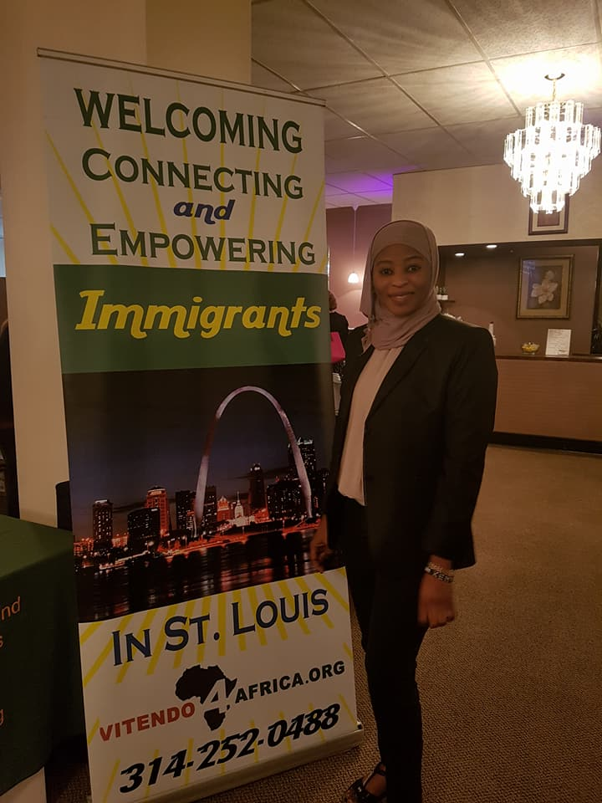
Limitations
Response rate
Low rate of response via Qualtrics survey
Only some mentees able to provide experience during group session
Forced binary responses
Many questionnaire items would improve from in depth, qualitative responses, but binary (yes/no) responses were necessary for manageable analyses.
Qualitative responses may not represent all mentors/mentees

Slide 12
Evaluation Findings
and Observations
Notes:
Dan Ferris and Jacob Fussell
Quantitative analysis

Slide 13
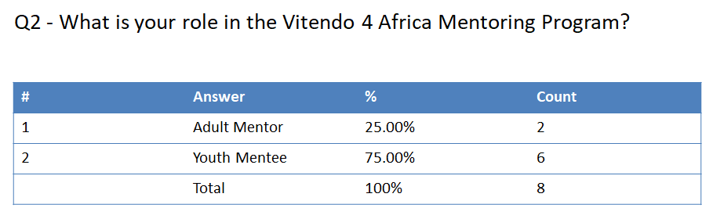
Survey Results

Slide 14
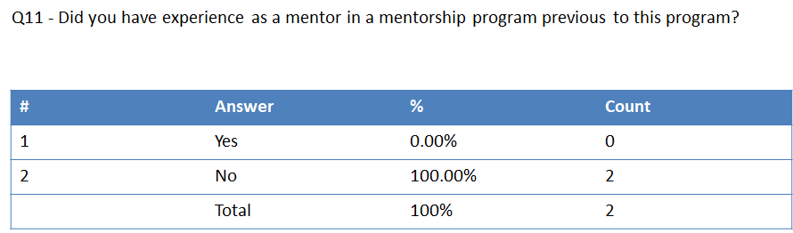
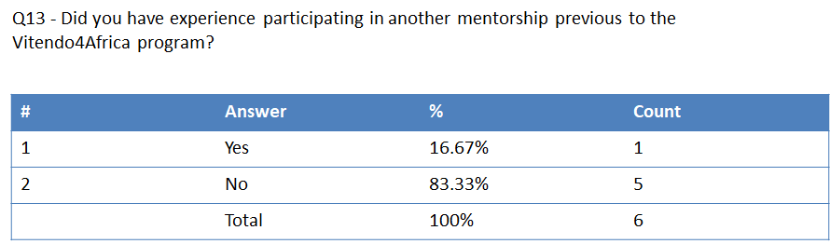
Notes:
Low level of previous hands-on experience.

Slide 15
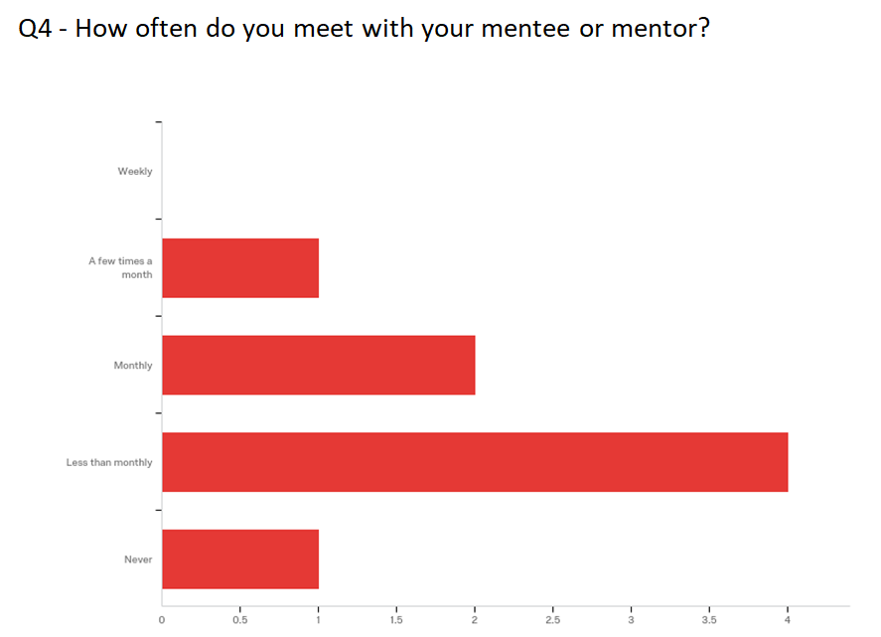
Notes:
Over half the sample is not meeting as regularly as program outlines.

Slide 16
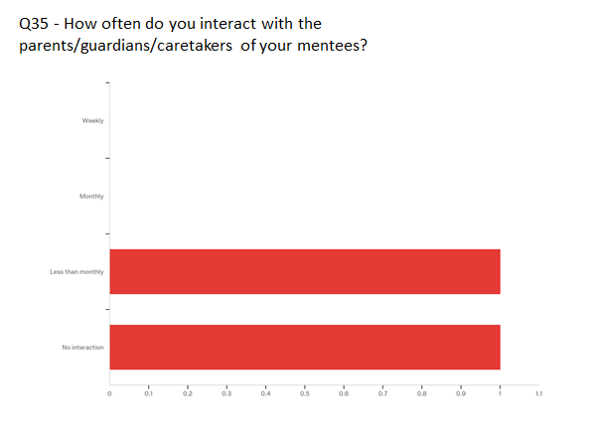
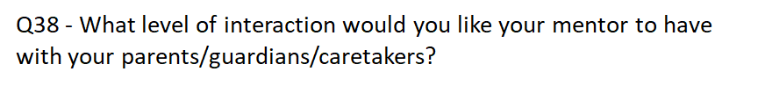
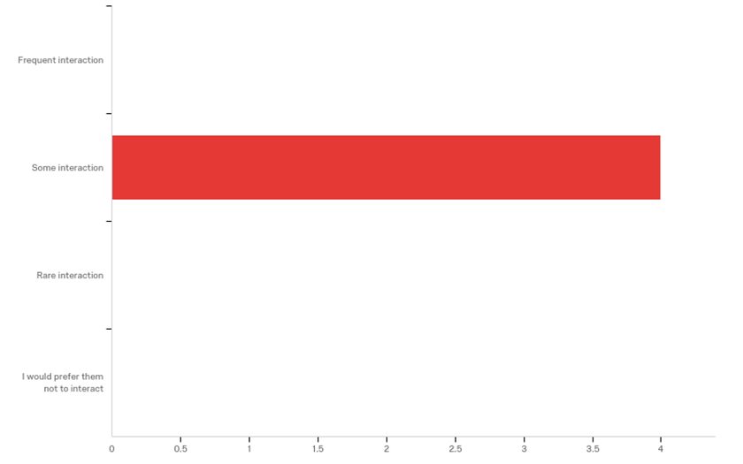
MENTORS
MENTEES

Slide 17
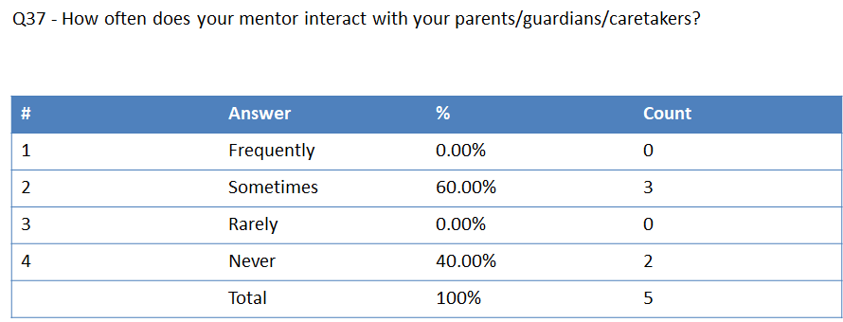
Notes:
The amount of parental involvement seems to be generally satisfying for those mentors who interact with their mentee’s guardian

Slide 18
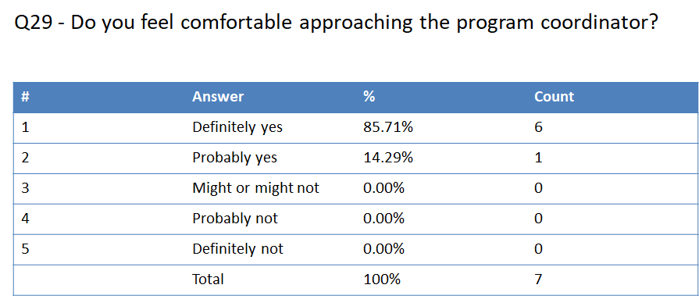

Slide 19
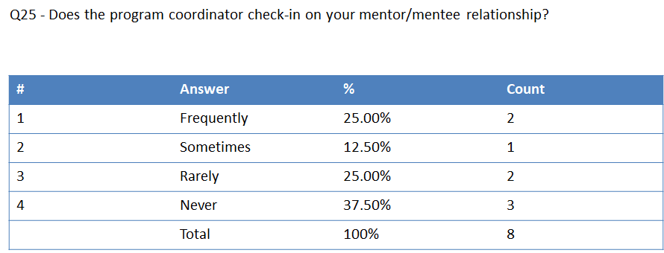
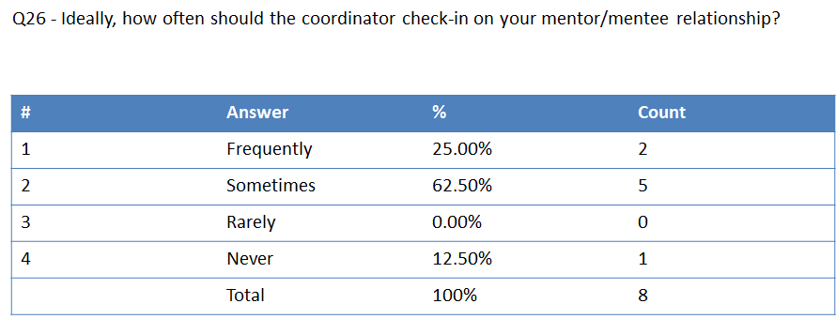

Slide 20

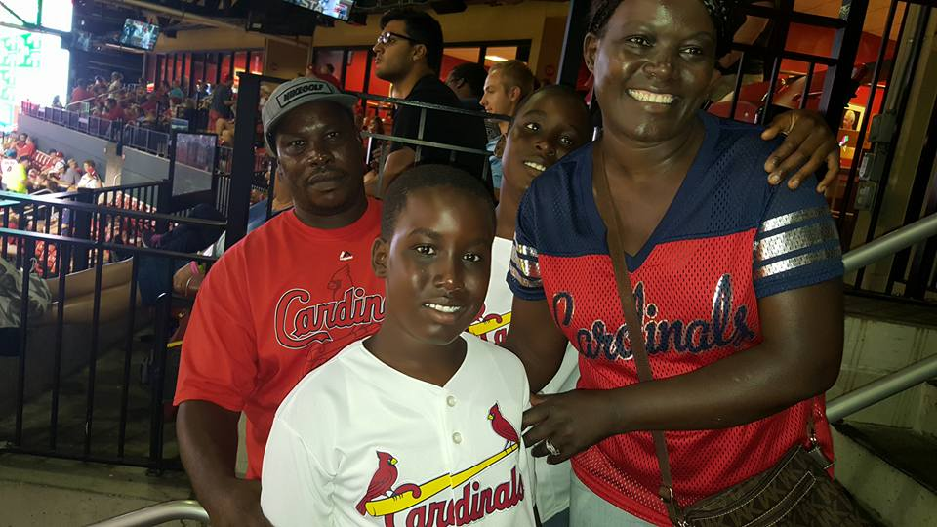
Orientation and End-of-Year Activity
For the individuals who participated, they felt that the activities added value to the program, their mentor/mentee relationships, and increased their confidence in the program.
Notes:
Overall all success

Slide 21
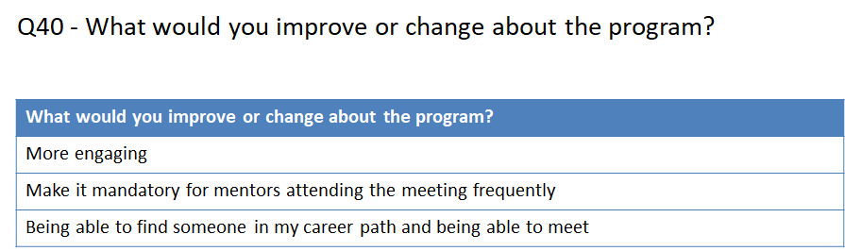

Slide 22
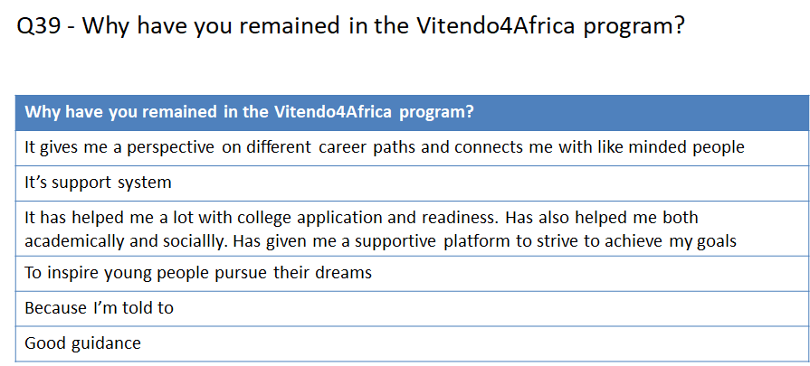

Slide 23
Qualitative Evaluation Summary & Analyses
Notes:
Melissa

Slide 24
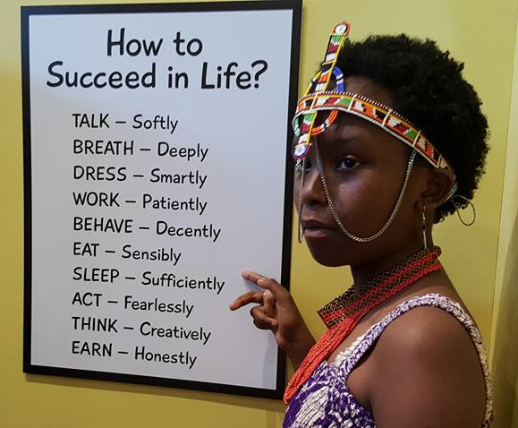
Qualitative Response Analyses
Two sets of group interviews conducted for qualitative analyses
Phone interviews with mentors
In-person group interview with mentees
Analyses focussed on
General themes and quantity of similar responses
Unique insights and experiences
Why gather qualitative data?
Quantitative (statistical) data can explain general trends, but qualitative data from open ended responses gives us an idea about why trends may be occurring in the program and possible insight into problems and solutions.

Slide 25
Mentor Phone Interviews
General Themes:
“Feel like I’m making a difference.”
Confidence in program
Program success in providing guidance and tools
Meet with mentees ~1 per month
Average 2-3 mentees who are well matched to mentor
Would like to see program expansion in future
Would like greater representation from jobs outside of white collar professional
Greater need for parental involvement or education of parents

Slide 26
Mentor Phone Interviews
Unique Insights on Various Topics Regarding:
Parent involvement:
Would like to see parents involved from the beginning and at more meetings.
Would be wary of parents giving conflicting information from mentors and would want parents to receive education or informational sessions.
Would like parents to receive information about college application process.
Meeting with mentees:
Meetings occur once per month at most and are arranged via text when convenient; usually occur in conjunction with planned monthly meeting and are professional.
Meetings occur frequently and also include personal phone calls and texts almost daily to maintain contact beyond just professional ties.
Rapport with mentees:
Difficult building rapport due to age difference.
Takes daily contact to build rapport, but it is possible.

Slide 27
Mentor Phone Interviews
Improvement to program:
Creating an app for all mentors, mentees, and parents to access and communicate with one another
Better feedback
More diverse mentees from other immigrant communities
Expand program to other Kenyan diasporas across US
Get mentors from outside of white collar professions
Add less structured activities that don’t just focus on professionalism
Add 1-2 good workshops each year for mentees and parents
Improve participation from parents
Get participants excited about the outcomes

Slide 28
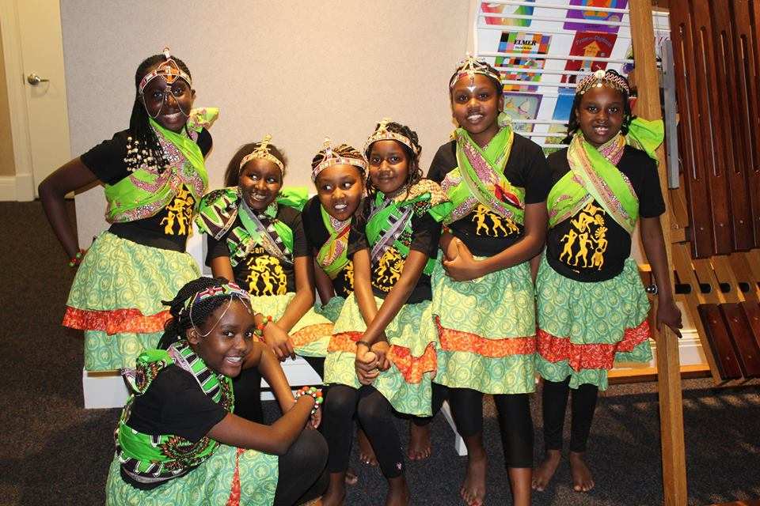
Mentee Group Interview
Conducted at Nov 2018 monthly meeting with ~15 mentees
Included mentees who had been part of the program since the beginning, those who had joined part way through, and new mentees not yet with mentors
Private interview between only mentees and assessors
Comprised of
open discussion of program
guided questioning following questionnaire items established previously for mentors/mentees
Lasted ~1 hour

Slide 29
Mentee Group Interview
General Themes:
Effectiveness of program at creating professional contacts
Effective college preparation
Gives perspectives to life and future beyond school
Mentor-Mentee match is fairly close for professional interests
Would like increased meeting time with mentors (from once per month to 2)
Need more social gatherings to feel close with mentors
Lack of transportation to meetings is a major issue
“Kenyan Time” still an issue

Slide 30
Mentee Group Interviews
Specific Issues:
Transportation
Need better transportation system for mentees who need rides to meetings and events
Low monthly meeting attendance
Would like more people to attend
But do not want to change time
Large age differences between mentors and mentees
Mentors are often difficult to meet
May only see them once per month at most (sometimes only once every 2-3 months)
Would like to increase meeting amount or have increased communication
Specific Wishes:
More frequent social events to improve relationships with mentors
E.g., barbeques, going to park, playing games, bowling, sporting events
Access to shadowing jobs outside of those typically seen (e.g., medicine, law, engineering)
Parental involvement
Want parents to receive outside informational meetings about college application process
Want combined parent-mentor-mentee meeting once every ~3 months

Slide 31
Recommendations

Slide 32
Have mentors and youth use the Fast Friends (FF) Procedure to establish trust and build rapport.
The success of mentorship significantly depends on the nature of the relationship between mentor and protégé.
Youths indicated that whether or not they opened up to mentors depended on their comfort level with mentors and belief that mentors would maintain confidences.
FF is an approach for quickly establishing trust and building deep relationships.
Aron, A., Melinat, E., Aron, E. N., Vallone, R. D., & Bator, R. J. (1997). The Experimental Generation of
Interpersonal Closeness: A Procedure and Some Preliminary Findings. Personality and Social Psychology Bulletin, (4).
University of California - Berkeley. (n.d.) Fast Friends procedure full protocol used in Page-Gould,
Mendoza-Denton, & Tropp (2008).
Notes:
Slide prepared by Malcolm Townes.

Slide 33
Establish positive and negative incentives and provide support resources to encourage consistent attendance and on-time arrival for program events and activities.
Mentors and youths indicated that people arriving late to programs and events was an issue.
More than half of the youths arrived to the focus group session more than 10 minutes after the designated start time.
Youths indicated that consistent transportation was often an impediment that prevented many of their peers from participating.
Youths indicated that mentors cancelling meetings because of other obligations was a regular occurence.
5 of 8 survey respondents reported not scheduling future meetings before leaving a current meeting.
Notes:
Slide prepared by Malcolm Townes.

Slide 34
Encourage and facilitate appropriate parental involvement by planning and scheduling quarterly activities that specifically involve the parents of youth participants.
Youths and mentors indicated a desire for parental involvement greater than current levels.
Most youths indicated they were fine with mentors interacting with their parents.
Youths indicated that they would be uncomfortable with parental involvement in all program activities.
Work schedules and fatigue were cited as the primary impediments preventing parents from being more regularly involved.
Suggestions
Non-career focused social activities that include parents.
Have mentors provide mentorship to parents also.
Provide parents with suggestions for activities to do and topics to discuss with their children.
Notes:
Slide prepared by Malcolm Townes.

Slide 35
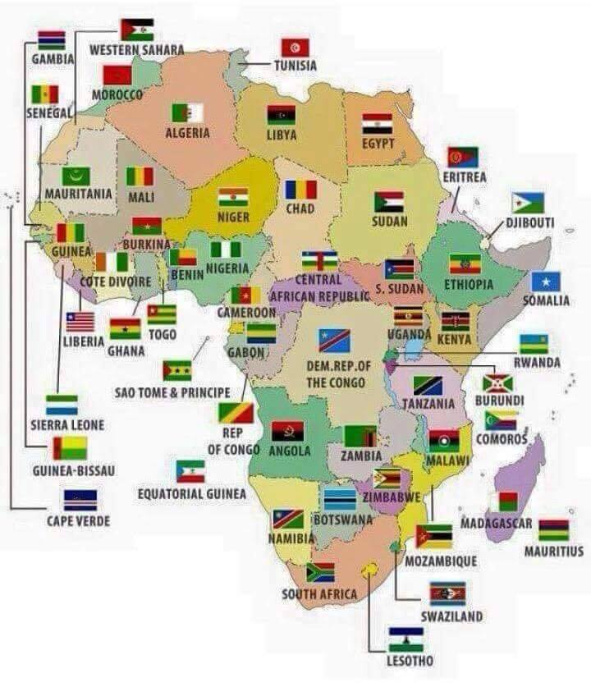
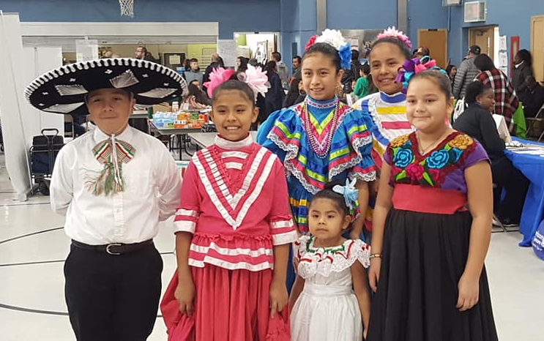
Consider expanding participation beyond the Kenyan immigrant community.
Youths indicated that the program’s exclusive focus on attracting program participants from the Kenyan immigrant community was a limitation.
Exclusive focus on participants from the Kenyan immigrant community limits the pool of potential resources for the program.
Suggestions
Recruit mentors from outside the Kenyan immigrant community.
Partner with other mentor programs for specific activities.
Partner with other service programs in the St. Louis community.
Notes:
Slide prepared by Malcolm Townes.

Slide 36
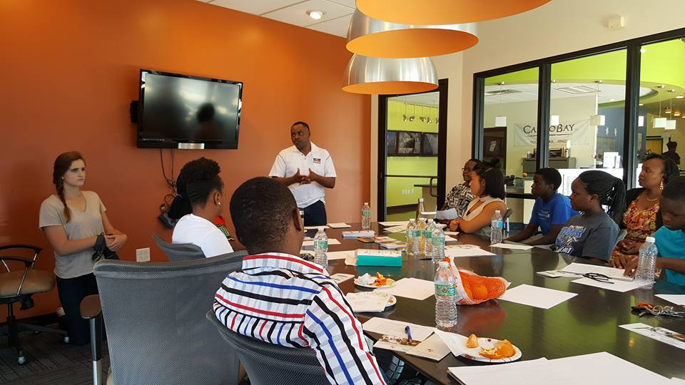
Consider relocating primary group meeting location to a larger, more conveniently located facility.
The conference room in the 7720 N. Lindbergh location has limitations:
Can only comfortably accommodate 10 to 12 people.
Room arrangement not particularly conducive to some types of activities.
Location is somewhat isolated.
Suggestions
Florissant Valley Branch of St. Louis County Library System
Prairie Commons Branch of St. Louis County Library System.
Notes:
Slide prepared by Malcolm Townes.

Slide 37
References
Aron, A., Melinat, E., Aron, E. N., Vallone, R. D., & Bator, R. J. (1997). The Experimental Generation of Interpersonal Closeness: A Procedure and Some Preliminary Findings. Personality and Social Psychology Bulletin, (4), 363. Retrieved from http://ezp.slu.edu/login?url=http://search.ebscohost .com/login.aspx?direct=true&db=edsbl&AN=RN023285782&site=eds-live.
Aschenbrener, C., & Johnson, S. (2017). Educationally-Based, Culturally-Sensitive, Theory-Driven Mentorship Intervention with At-risk Native American Youth in South Dakota: A Narrative Review. Journal of Child & Family Studies, 26(1), 14-27. doi:10.1007/s10826-016-0537-z
Brittian, A. S., Sy, S. R., & Stokes, J. E. (2009). Mentoring: Implications for African American College Students. Western Journal of Black Studies, 33(2), 87-97.
Ching, A. M., Yeh, C. J., Siu, W. Y., Wu, K. A., & Okubo, Y. (2009). Evaluation of a School-based Internship Program for Chinese Immigrant Adolescents in the United States. Adolescence, 44(175), 601-620.
Fernandes-Alcantara, A. L. (2015). Vulnerable Youth: Federal mentoring programs and issues.
Rhodes, J., Reddy, R., Roffman, J., & Grossman, J. (2005). Promoting successful youth mentoring relationships: A preliminary screening questionnaire. Journal of Primary Prevention 26: 147-168.
University of California - Berkeley. (n.d.) Fast Friends procedure full protocol used in Page-Gould, Mendoza-Denton, & Tropp (2008). Retrieved from https://rascl.berkeley.edu/tools.html.
Vitendo 4 Africa Mentoring Program. V4A Revised March 29, 2017.
Walker, G. (2007). Mentoring, policy, and politics. Philadelphia: Public/Private Ventures.

